Slide 1
SALES ANALYTICS REPORT
Bright Coffee Shop
Sales Analysis
Turning 149,116 transactions into an executive growth story
Prepared by: Mashudu Data Analyst Date: Mashudu Sivhada

Slide 2
EXECUTIVE SUMMARY
Revenue is doubling, and mornings drive it
2
R698,812
+103.8%
66.7%
55.6%
TOTAL REVENUE
REVENUE GROWTH
COFFEE + TEA SHARE
REVENUE BEFORE NOON
Jan–Jun, all three stores
R81,678 Jan to R166,486 Jun
R466,358 of total revenue
06:00–11:59 trading window
What the numbers say
Momentum is real, not seasonal noise: revenue rose in four consecutive months, with the largest step-up between April and May (+31.8%).
The business is concentrated in hot drinks — Coffee (R269,952) and Tea (R196,406) contribute two thirds of revenue from a wide 80-product range.
The morning window (06:00–11:59) alone generates R388,289; the evening window (18:00–20:59) contributes just R65,669.
All three stores perform within 2.8% of each other (R230,057 – R236,511), so growth is a network-wide trend, not a single-site effect.
Weekdays deliver 72.1% of revenue (R503,588) — this is a commuter-led business.
Figures calculated from the cleaned transaction dataset powering the Bright Coffee Shop executive dashboard.

Slide 3
CONTEXT
Dataset & business overview
3
149,116
214,470
R4.69
80
TRANSACTIONS
UNITS SOLD
AVERAGE ORDER VALUE
PRODUCTS
Individual sales records
Total transaction quantity
Revenue per transaction
Across 9 categories
Scope & dimensions
Preparation & tooling
Period: January – June, six complete trading months.
Stores: Astoria, Hell's Kitchen, Lower Manhattan.
Product hierarchy: category → type → product detail.
Time dimensions: month, day of week, weekday/weekend, day period and 3-hour trading buckets.
Excel for initial cleaning; SQL transformations in Databricks.
Purchase time extracted, then classified into Breakfast Rush, Morning, Lunch, Afternoon and Evening.
total_amount = unit_price × transaction_qty.
Results published to an interactive executive dashboard, filterable across eight dimensions.
No records were excluded; every figure in this deck traces back to the cleaned dataset.

Slide 4
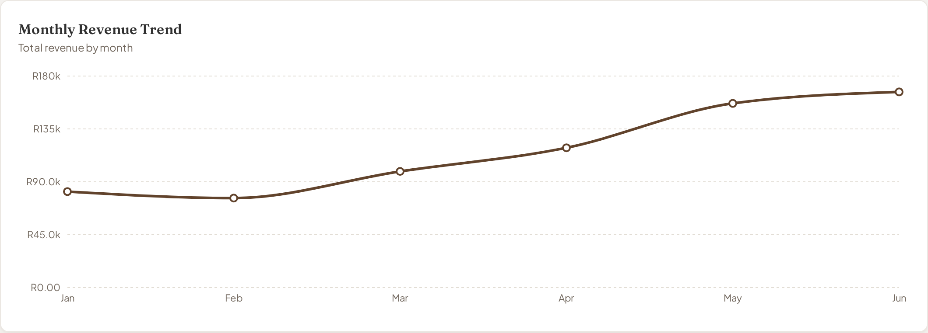
PERFORMANCE
Overall performance: growth accelerating
4
Read-out
Revenue more than doubled over six months, from R81,678 to R166,486.
February was the only dip (R76,145) — the base month for the recovery.
March–June added R90,341 of monthly run-rate.
June is the strongest month in this dataset.
+103.8% growth
January → June
Monthly revenue, January – June
Monthly revenue trend as shown on the executive dashboard.

Slide 5
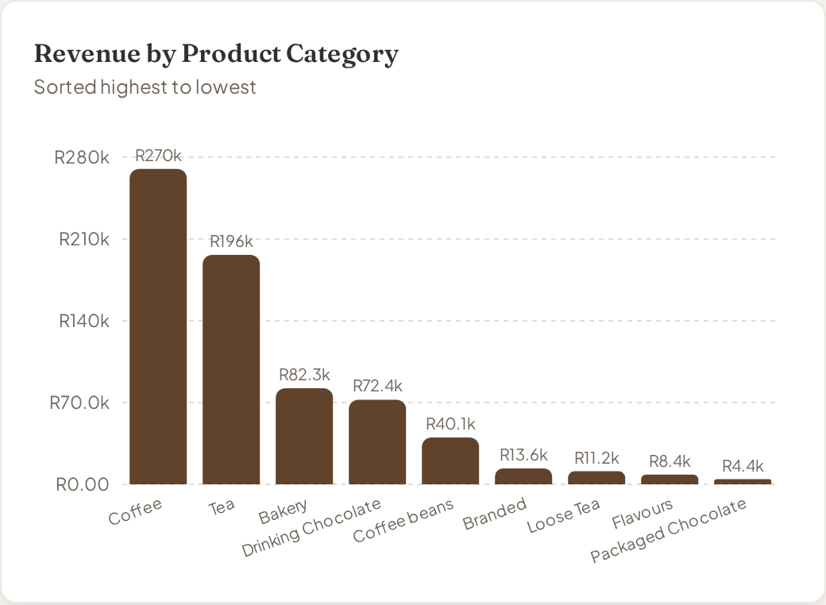
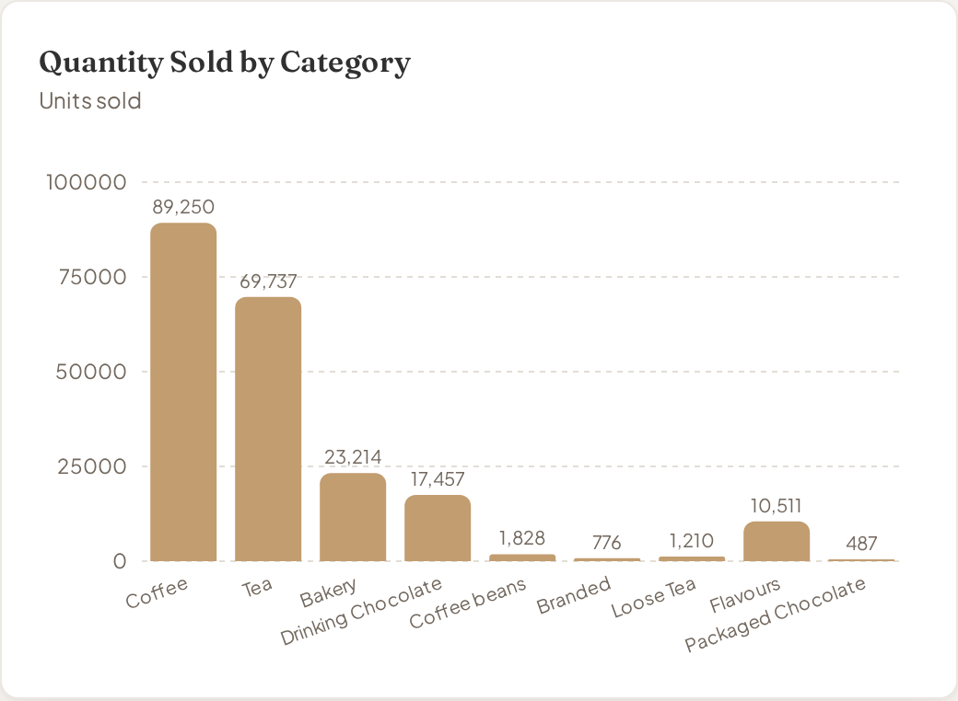
MIX
Category performance: top and lowest contributors
5
Coffee leads on both revenue (R269,952) and volume (89,250 units), with Tea second on R196,406. Packaged Chocolate is the smallest line at R4,408 — under 1% of revenue.

Slide 6
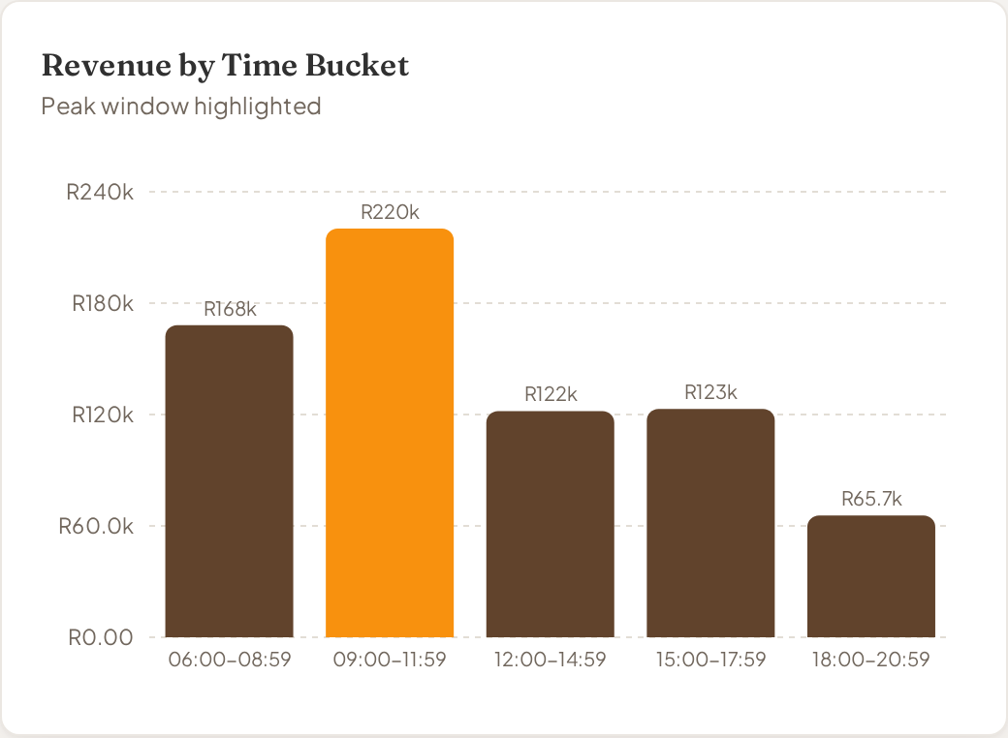
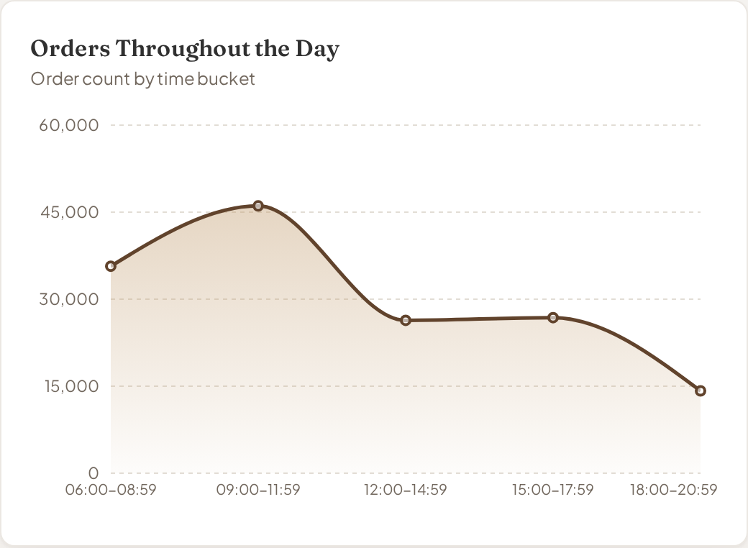
TRENDS
Trading patterns through the day
6
The 09:00–11:59 bucket is the single biggest window at R220,162 from 46,075 orders. Evening trade (18:00–20:59) is less than a third of that at R65,669.

Slide 7
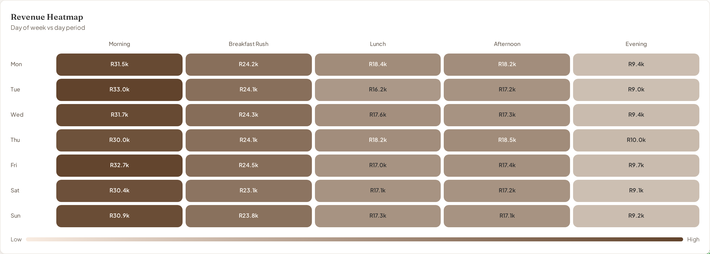
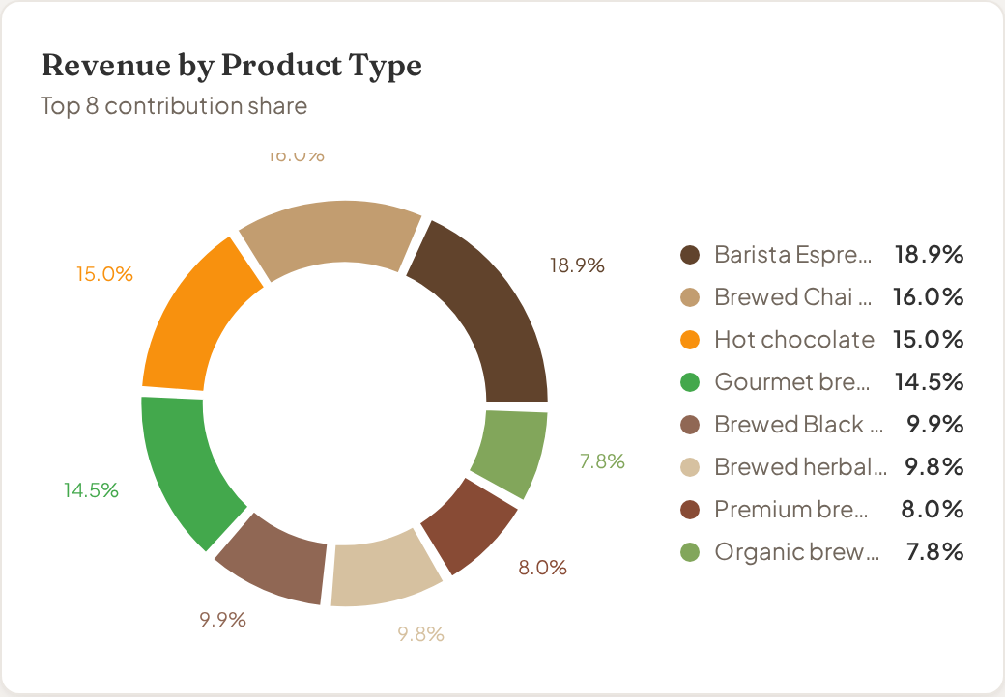
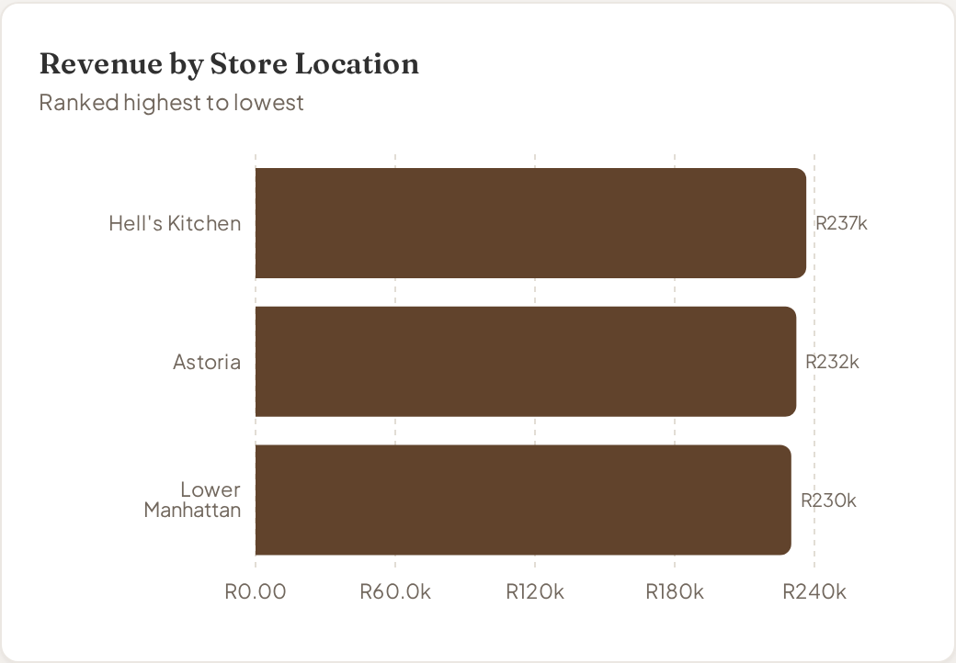
DEEPER ANALYSIS
Where product mix meets timing and location
7
Demand is flat across the week (Mon R101,677 vs Sat R96,894) but sharply peaked by day part.
Barista Espresso (R91,406) and Brewed Chai tea (R77,082) lead the product mix.
Store revenue is near-identical, so decisions apply network-wide.
Day-of-week vs day-period heatmap, product-type mix and store ranking, all from the dashboard.

Slide 8
INSIGHTS
Finding → evidence → business implication
8
FINDING
EVIDENCE
IMPLICATION
Growth is compounding
Revenue rose from R81,678 (Jan) to R166,486 (Jun), +103.8%.
Plan capacity and stock against a rising baseline, not last year's average.
Mornings carry the business
06:00–11:59 delivers R388,289, 55.6% of all revenue.
Protect service speed before noon; this is where revenue is won or lost.
Two categories dominate
Coffee R269,952 and Tea R196,406 = 66.7% of revenue.
Range decisions outside these two lines carry limited revenue risk.
The long tail is thin
The five weakest products together earn under R6,100.
Simplify the menu to cut complexity without material revenue loss.
Stores behave identically
R230,057 – R236,511 across all three sites (2.8% spread).
Roll out changes as one network programme, not site-by-site pilots.

Slide 9
ACTIONS
Recommendations
9
01
Staff and stock for the morning peak
46,075 orders land between 09:00 and 11:59. Align rosters and prep volumes to that window before adding cover anywhere else.
02
Protect the top ten products
The ten best sellers generate R177,375. Guarantee availability of Sustainably Grown Organic Lg, Dark chocolate Lg and Latte Rg above all else.
03
Activate the evening window
Evenings earn R65,669 — the weakest of five windows. Test a timed after-16:00 offer on Coffee and Bakery to lift a proven quiet period.
04
Rationalise the long tail
Of 80 products, the weakest five earn under R6,100 combined. Delist or bundle them to reduce waste and simplify service.
05
Scale what works across all sites
With stores within 2.8% of each other, treat successful tests as network standards rather than local experiments.

Slide 10
CONCLUSION
A growing, morning-led business with room to simplify
SITUATION
OPPORTUNITY
RISK
NEXT STEP
R698,812 revenue from 149,116 transactions across three consistently performing stores.
Growth of +103.8% is concentrated in Coffee and Tea before noon — a repeatable, well-understood demand pattern.
Dependence on one day part and two categories; evening trade and 80-product complexity dilute focus.
Lock morning capacity, run an evening offer test, and review the weakest products at the next trading meeting.
Thank you · Questions welcome
Bright Coffee Shop | Sales Analysis

